Slide 1
E6156 – Topics in SW Engineering (F23) Cloud Computing Lecture 10: DynamoDB, Design Patterns, Composition, Asynch, Step Functions
© Donald F. Ferguson, 2023

Slide 2

Service Composition Continued
2 | E6156 – Topics in SW Engineering: Cloud Computing: Lecture 10: Design Patters, DynamoDB, Composition © Donald F. Ferguson, 2023

Slide 3
Overview/Review
Service Composition Continued
3 | E6156 – Topics in SW Engineering: Cloud Computing: Lecture 10: Design Patters, DynamoDB, Composition © Donald F. Ferguson, 2023

Slide 4
Concepts
There two core concepts in “composition:”
Structure:
“What is connected to what?”
“How does component A find the implementation of interface B that is uses?”
Behavior:
The internal logic of a component is encapsulated.
“What is the behavior of the overall system built on individual components behavior.”
There are logical or conceptual ways to think about and implement the concepts:
Structure: C4 Models, UML Class and Component Diagrams, Dependency Injection, Service Factory/Locator, … …
Behavior: State Machines, Sequence Diagrams, BPMN, Step Functions, Workflow Engines, … …

Slide 5
Structural Composition
Service Composition Continued
5 | E6156 – Topics in SW Engineering: Cloud Computing: Lecture 10: Design Patters, DynamoDB, Composition © Donald F. Ferguson, 2023

Slide 6
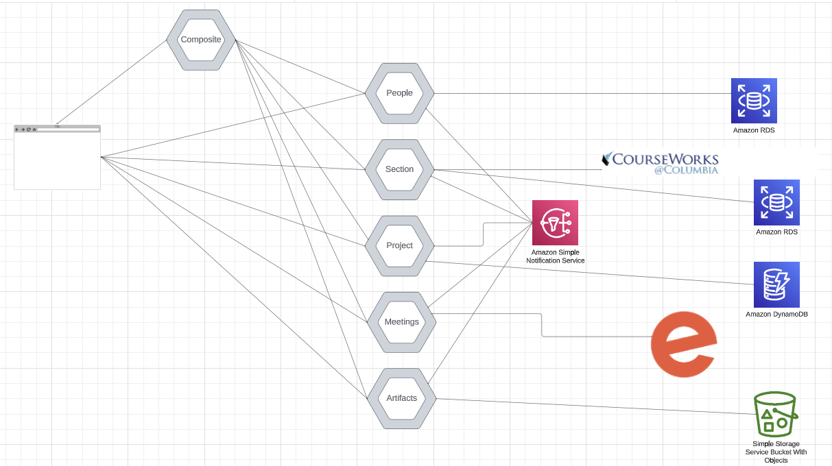
Structural Composition
There are a lot of lines connecting “components” and “services.”
How does this work?
Ultimately, the composition relies on URLs.
But, how does a service know the URLs?
Hardcoding is a bad idea.
Also, how do we encapsulate implementation changes to prevent cascading code changes?
There is not generally agreed approach, but there are various patterns.

Slide 7
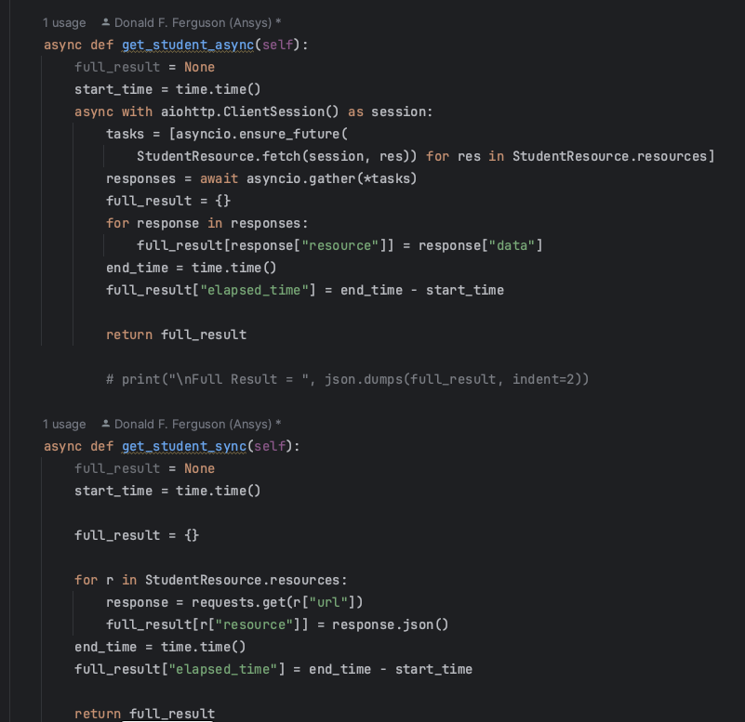
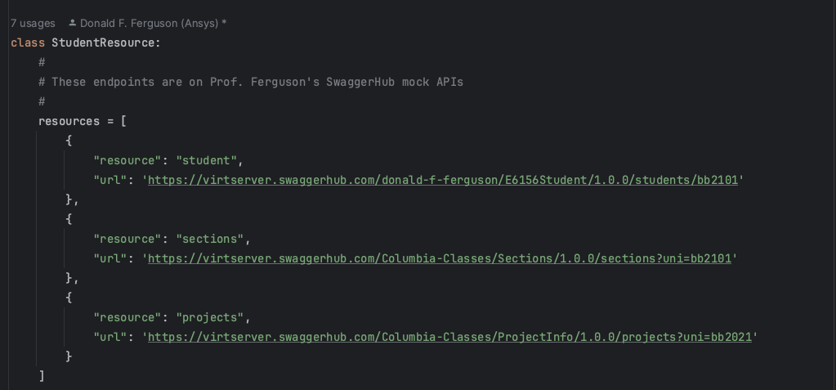
Do Not do This … …
Clearly, hard coding URLs, etc. is not the right approach.
But, other people must have solved this problem.

Slide 8
Design Patterns: A Digression
Service Composition Continued
8 | E6156 – Topics in SW Engineering: Cloud Computing: Lecture 10: Design Patters, DynamoDB, Composition © Donald F. Ferguson, 2023

Slide 9
Design Patterns
“In software engineering, a software design pattern is a general, reusable solution to a commonly occurring problem within a given context in software design. It is not a finished design that can be transformed directly into source or machine code. Rather, it is a description or template for how to solve a problem that can be used in many different situations. Design patterns are formalized best practices that the programmer can use to solve common problems when designing an application or system.” (https://en.wikipedia.org/wiki/Software_design_pattern)
Design patterns occur at many levels and contexts:
Data Modeling
Implementing OO applications, FastAPI applications, … …
Microservices
… …

Slide 10
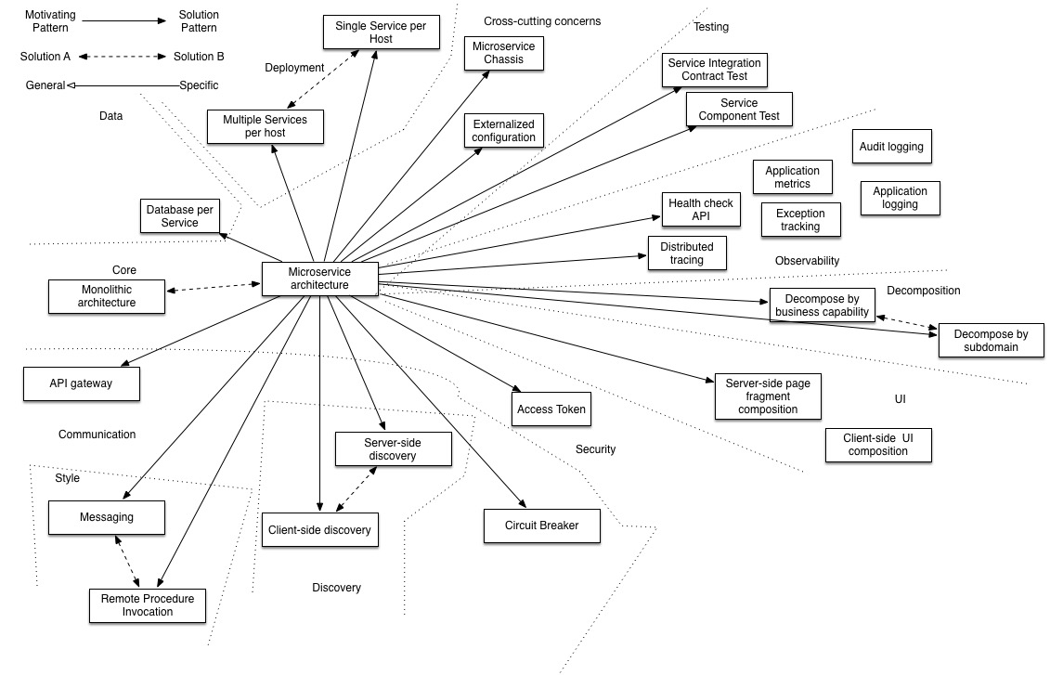
Microservice Patterns (One Perspective)

Slide 11
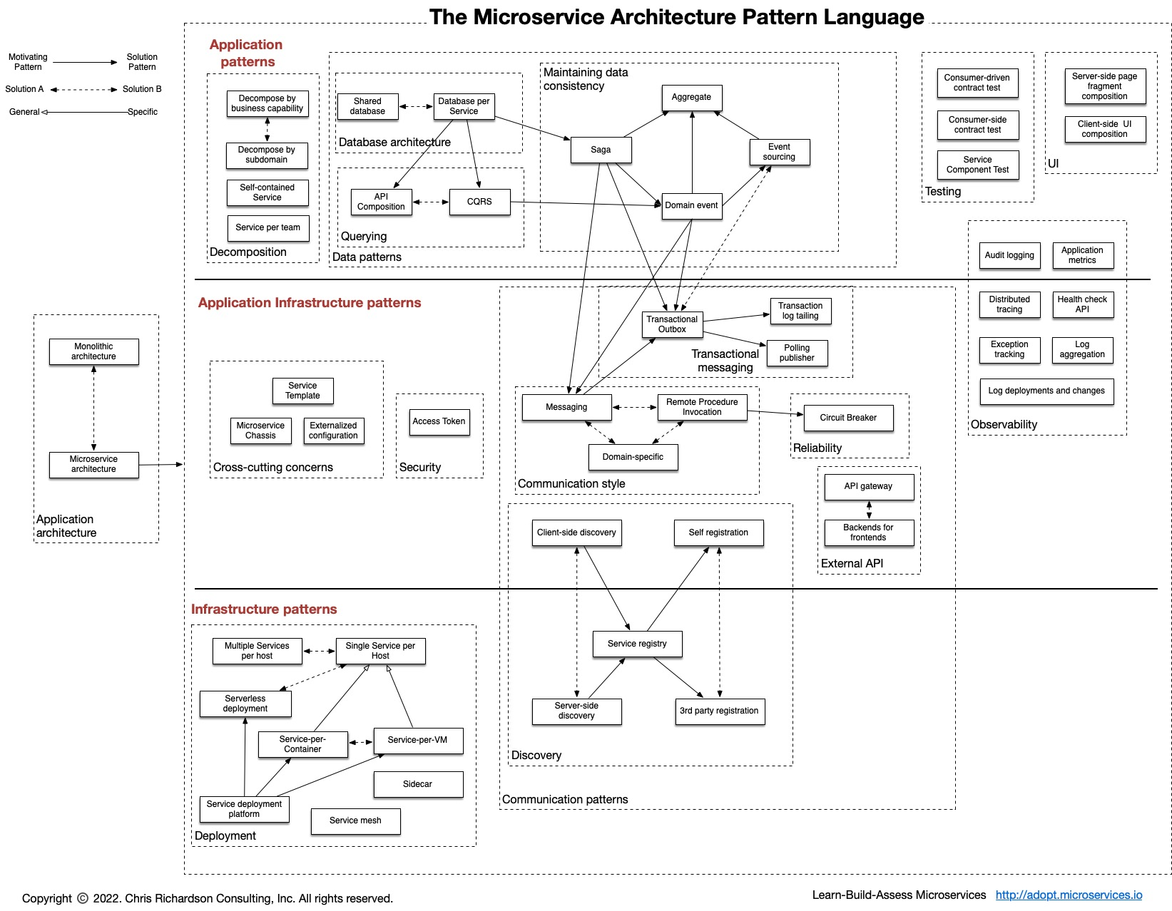
Microservice Pattern Language (One Perspective)
https://microservices.io/patterns/index.html

Slide 12
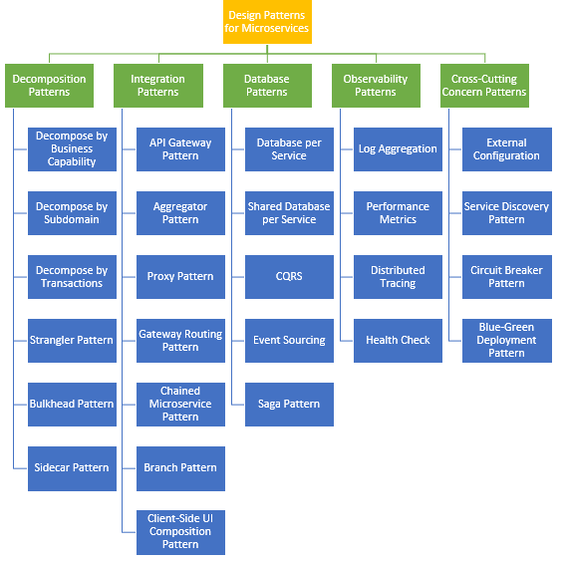
Microservice Pattern Language (One Perspective)
Some patterns that I regularly
Strangler
Sidecar
Aggregator
Database per Service
CQRS
Saga
External Configuration
… …

Slide 13
Composition Continued (Structure)
Service Composition Continued
13 | E6156 – Topics in SW Engineering: Cloud Computing: Lecture 10: Design Patters, DynamoDB, Composition © Donald F. Ferguson, 2023

Slide 14
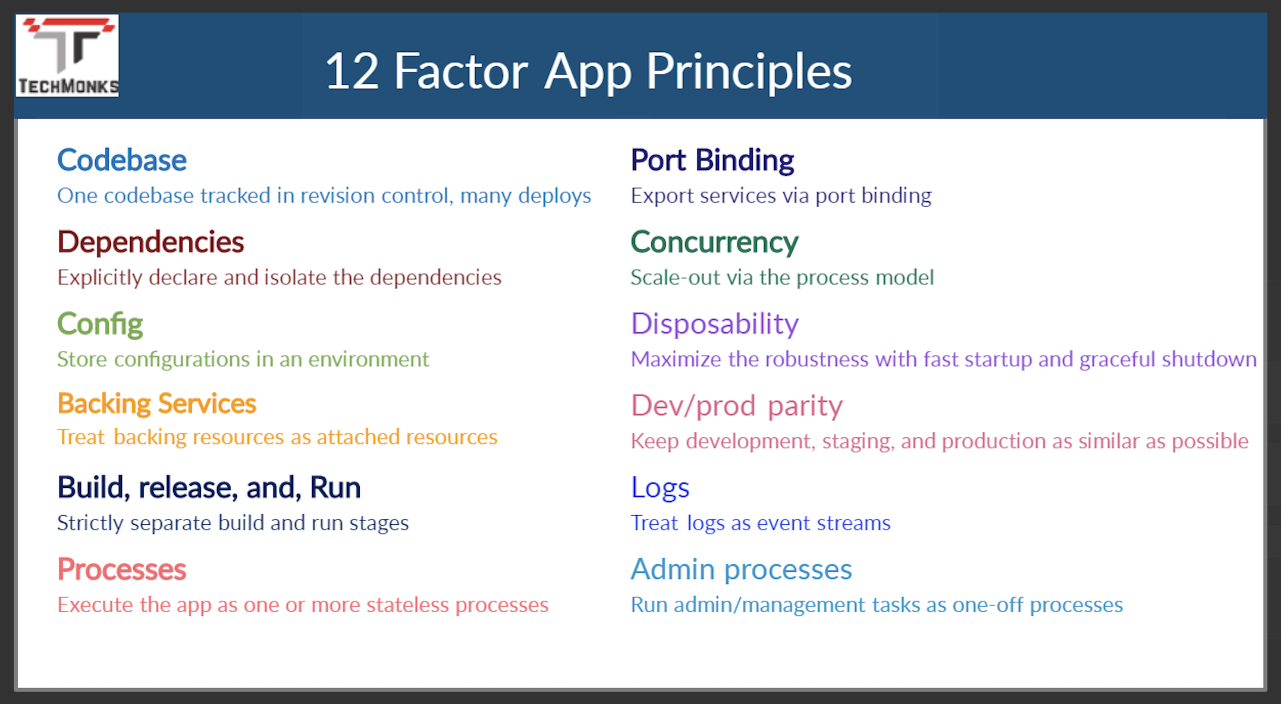
12 Factor Applications
https://dzone.com/articles/12-factor-app-principles-and-cloud-native-microser

Slide 15
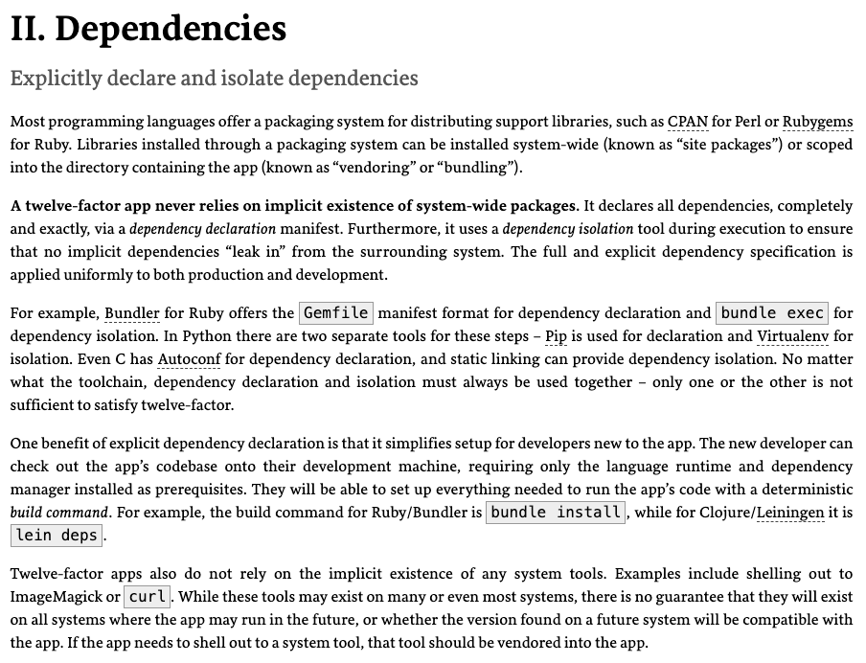
Dependencies
Most application frameworks have a dependency declaration concept.
I have been showing examples with:
Python import
requirements.txt
etc.
My examples also show encapsulating libraries and APIs with Python classes.
II. Dependencies handles “the code,” but we still need to handle the instance. There is a difference between, e.g.
pymysql
A specific connection.

Slide 16
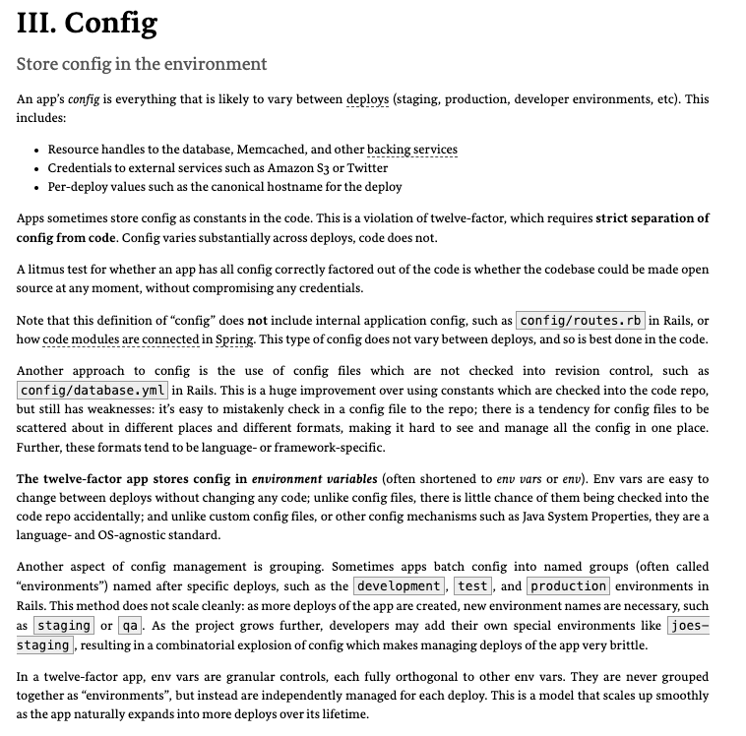
III. Configurations
Each of the deployment environments we have seen has a method for setting environment variables.
https://docs.aws.amazon.com/cloud9/latest/user-guide/env-vars.html
https://docs.aws.amazon.com/elasticbeanstalk/latest/dg/environments-cfg-softwaresettings.html
https://cloud.google.com/functions/docs/configuring/env-var
CI/CD, GitHub actions, etc. can integrate environment variables with the development process.
Vaults and secrets managers are a better approach for passwords.

Slide 17
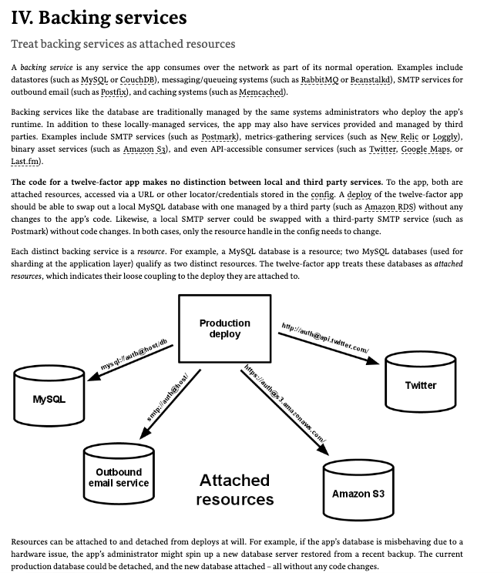
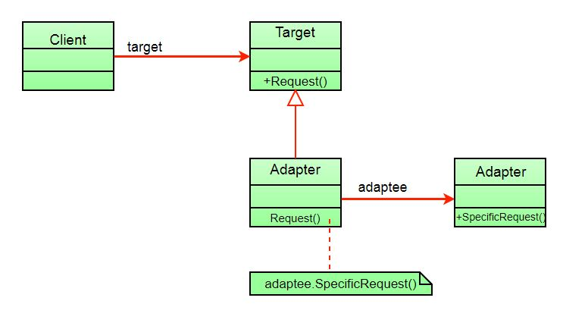
IV. Backing Services
My code has shown encapsulating backing services with a shallow adaptor.
This is an example of the adaptor pattern.
You seen examples of things like AbstractBaseDataService, … …
The approach is also an application of several aspects of SOLID. (https://en.wikipedia.org/wiki/SOLID)

Slide 18
Structural Composition
We can use four patterns/principles for service composition ”in code.”
Dependency Injection
Service Factory
Service Locator
Metadata in the environment for configuration.
I did some simple examples in https://github.com/donald-f-ferguson/E6156-Public-Examples/tree/master/simple_pattern_examples.
Or actually, I asked ChatGPT to produce simple examples.

Slide 19
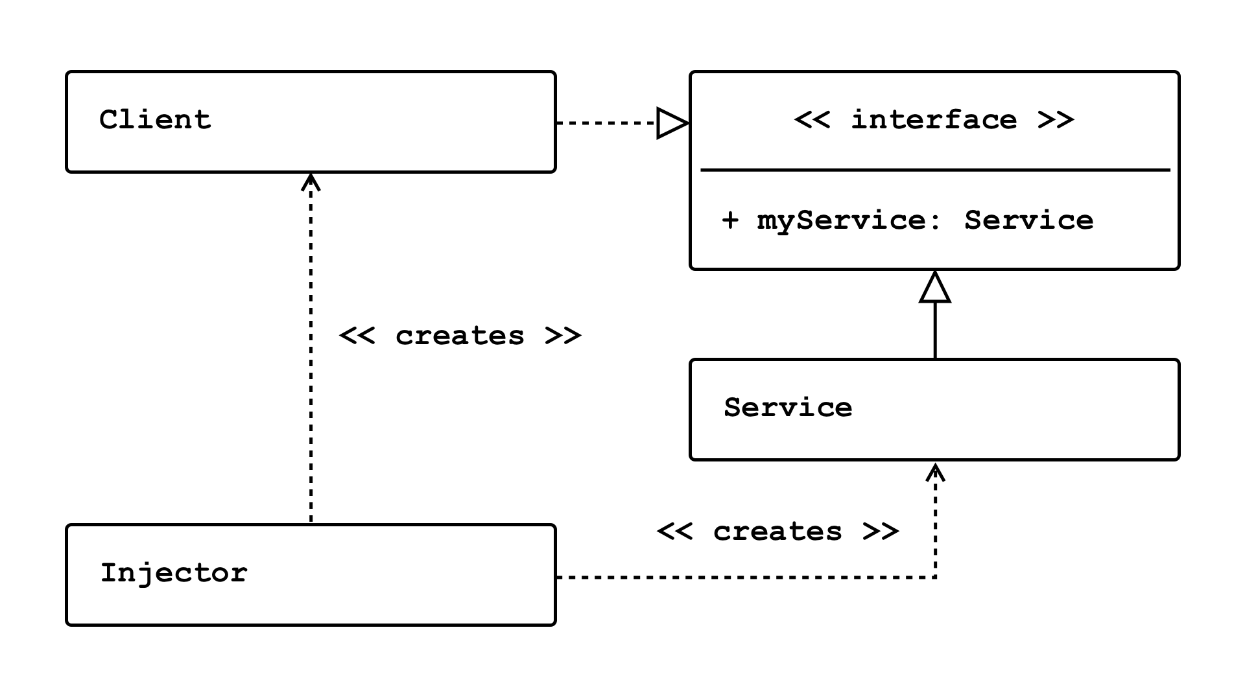
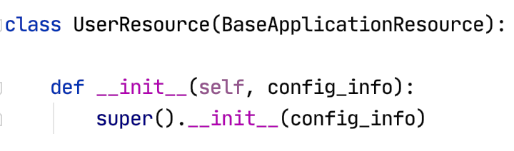
Dependency Injection
Concepts (https://en.wikipedia.org/wiki/Dependency_injection):
In software engineering, dependency injection is a technique in which an object receives other objects that it depends on, called dependencies.
The intent behind dependency injection is to achieve separation of concerns of construction and use of objects. This can increase readability and code reuse.
There is no single approach. There are several frameworks, tools, etc.
Like many other things, it is easy to get carried away and become dogmatic.
I follow a single approach:
A Context class converts environment and other configuration and provides to application.
The top-level application injects a config_info object into services.

Slide 20
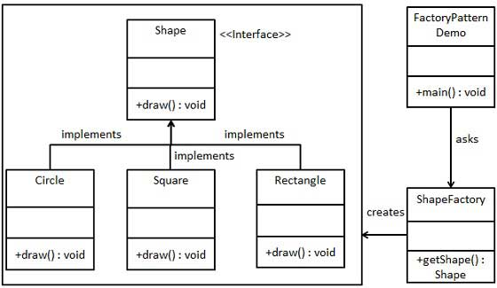
Service Factory
“In class-based programming, the factory method pattern is a creational pattern that uses factory methods to deal with the problem of creating objects without having to specify the exact class of the object that will be created. This is done by creating objects by calling a factory method—either specified in an interface and implemented by child classes, or implemented in a base class and optionally overridden by derived classes—rather than by calling a constructor.” (https://en.wikipedia.org/wiki/Factory_method_pattern)
You will sometimes see me use this for
Abstraction between a REST resource impl. and the data service.
Allows changing the database service, model, etc. without modifying the code.
Concrete implementation choices are configured via properties, metadata, …
You can use in many situations.
https://www.tutorialspoint.com/design_pattern/factory_pattern.htm

Slide 21
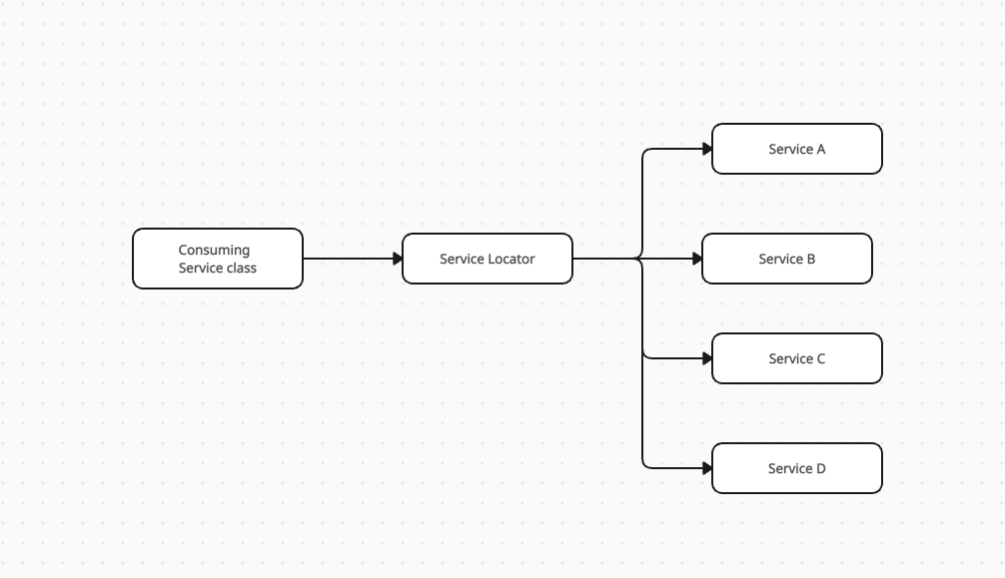

Service Locator
“The service locator pattern is a design pattern used in software development to encapsulate the processes involved in obtaining a service with a strong abstraction layer. This pattern uses a central registry known as the "service locator", which on request returns the information necessary to perform a certain task. Proponents of the pattern say the approach simplifies component-based applications where all dependencies are cleanly listed at the beginning of the whole application design, …” (https://en.wikipedia.org/wiki/Service_locator_pattern)
Configuration Information

Slide 22
Behavioral Composition
Service Composition Continued
22 | E6156 – Topics in SW Engineering: Cloud Computing: Lecture 10: Design Patters, DynamoDB, Composition © Donald F. Ferguson, 2023

Slide 23
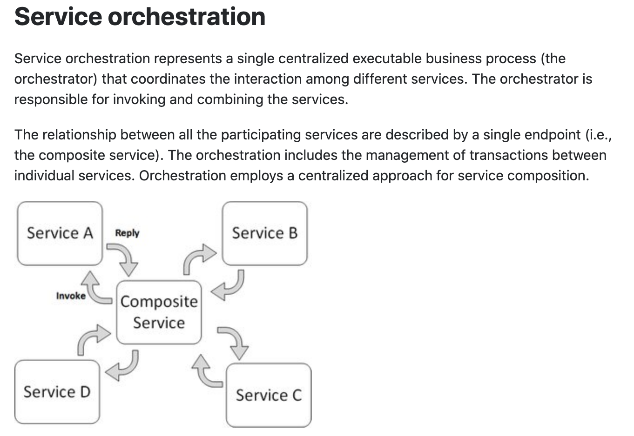
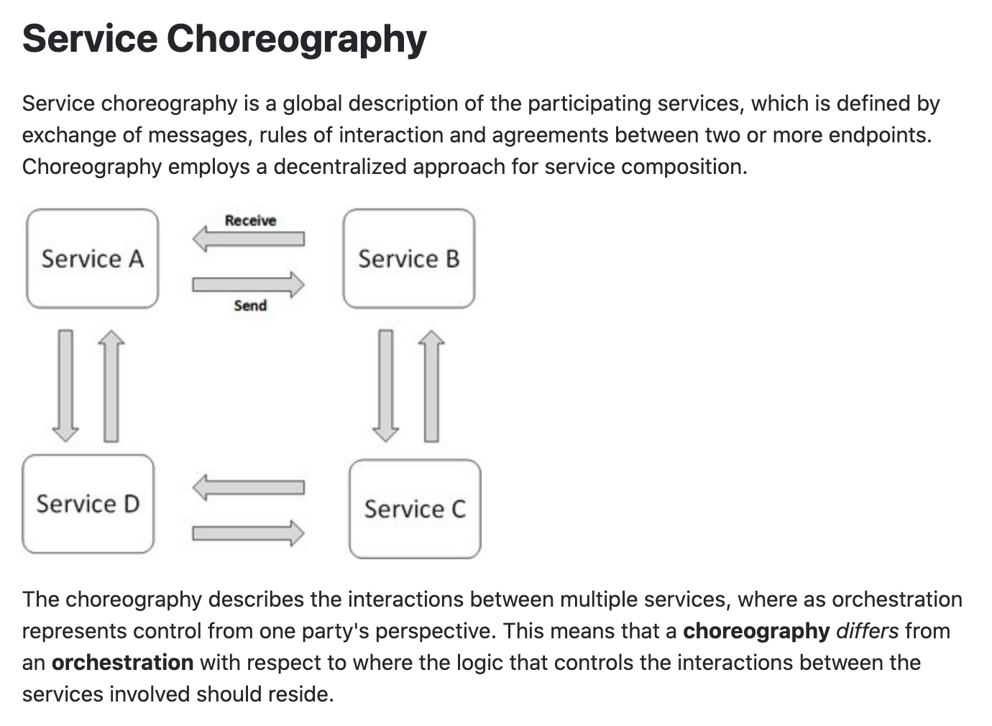
Concepts
These are not formally, rigorously defined terms.

Slide 24
In Code: Composition and Asynchronous Method Invocation
Composite operations can “take a while.”
“Holding open connections and waiting can be bad.”
Consumes resources.
Connections can break.
... ...
There are two options:
Polling
Callbacks
Our next pattern is composition and “polling.” Create a new user requires:
Updating the user database.
Verifying a submitted address.
Creating an account in the catalog service.
Request
202 ACCEPTED Location
GET (Poll)
200

Slide 25
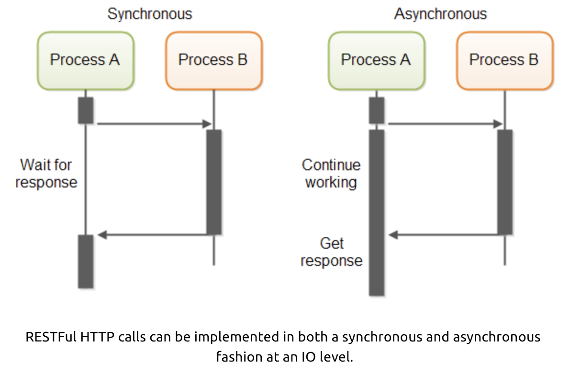
In Code: Service Orchestration/Composition
One call to a composite service
May drive calls to multiple other services.
Which in turn, may drive multiple calls to other services.
Synchronous (Wait) and calling one at a time, in order is
Inefficient
Fragile
... ...
Asynchronous has benefits but can result in complex code.

Slide 26
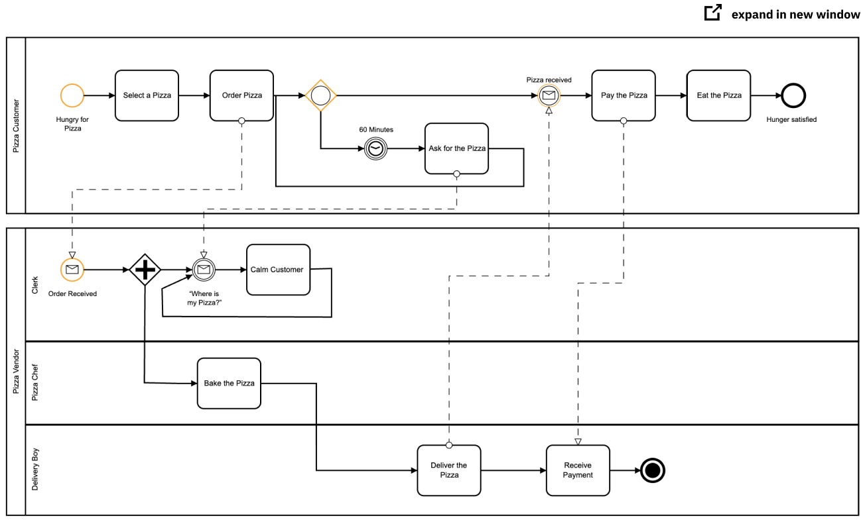
Service Orchestration
Implementing a complex orchestration in code can become complex.
High layer abstractions and tools have emerged, e.g. BPMN.
“Business Process Model and Notation (BPMN) is a graphical representation for specifying business processes in a business process model.”
There are products for defining BPMN processes, generating code, executing, … …, e.g. Camunda: https://camunda.com/bpmn/
There are other languages, tools, execution engines, … …

Slide 27
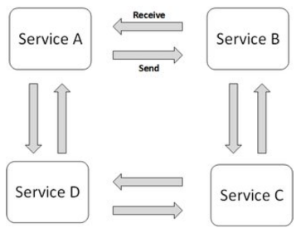
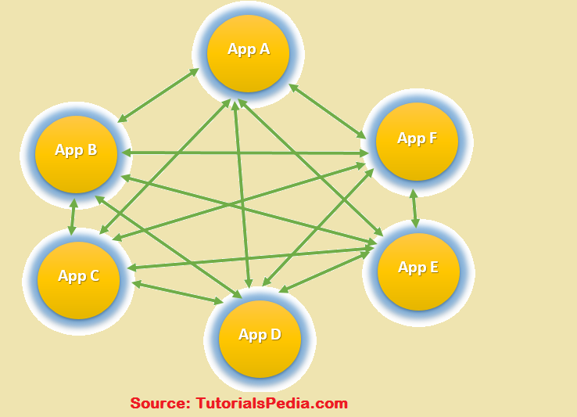
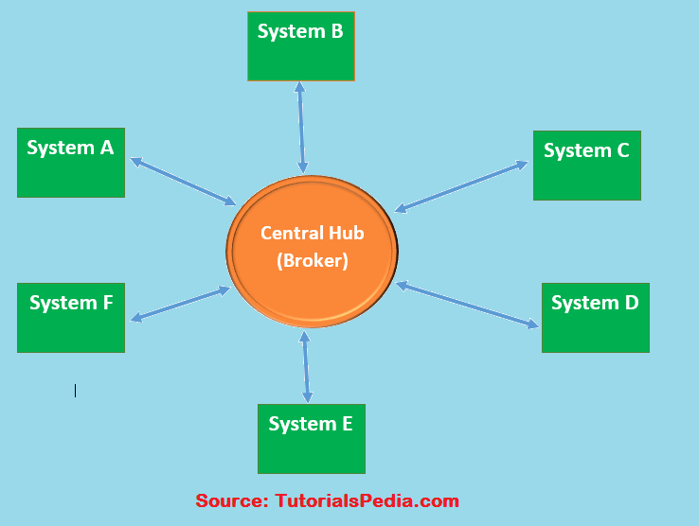
Choreography
We saw the basic diagram, but … this is an anti-pattern and does not scale.
But, how do you write the event driven microservices?
Well, you can just write code … …
Or use a state machines abstraction.

Slide 28
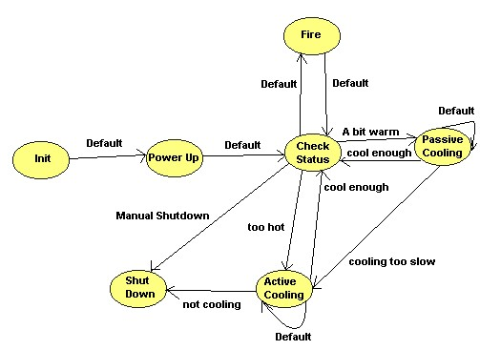
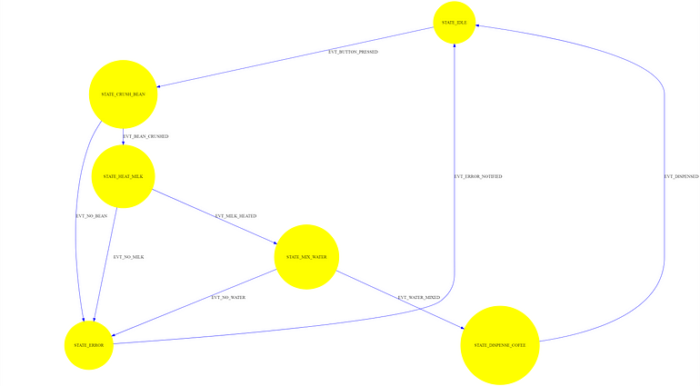
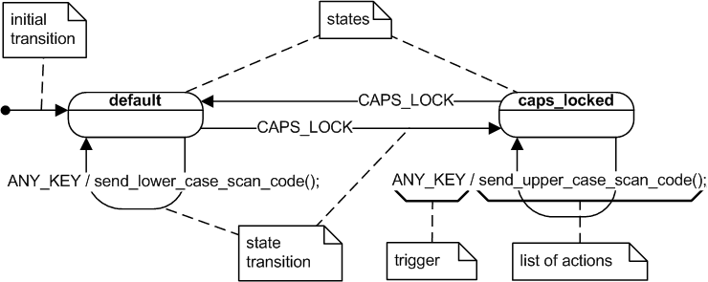
State Machine
A state machine is an abstraction.
There are many models for defining state machines.
There are also development tools, runtimes, … …
We will look at a specific example: AWS Step Functions

Slide 29
Step Functions Switch to Amazon Presentation
29 | E6156 – Topics in SW Engineering: Cloud Computing: Lecture 10: Design Patters, DynamoDB, Composition © Donald F. Ferguson, 2023

Slide 30
NoSQL and DynamoDB
30 | E6156 – Topics in SW Engineering: Cloud Computing: Lecture 10: Design Patters, DynamoDB, Composition © Donald F. Ferguson, 2023

Slide 31
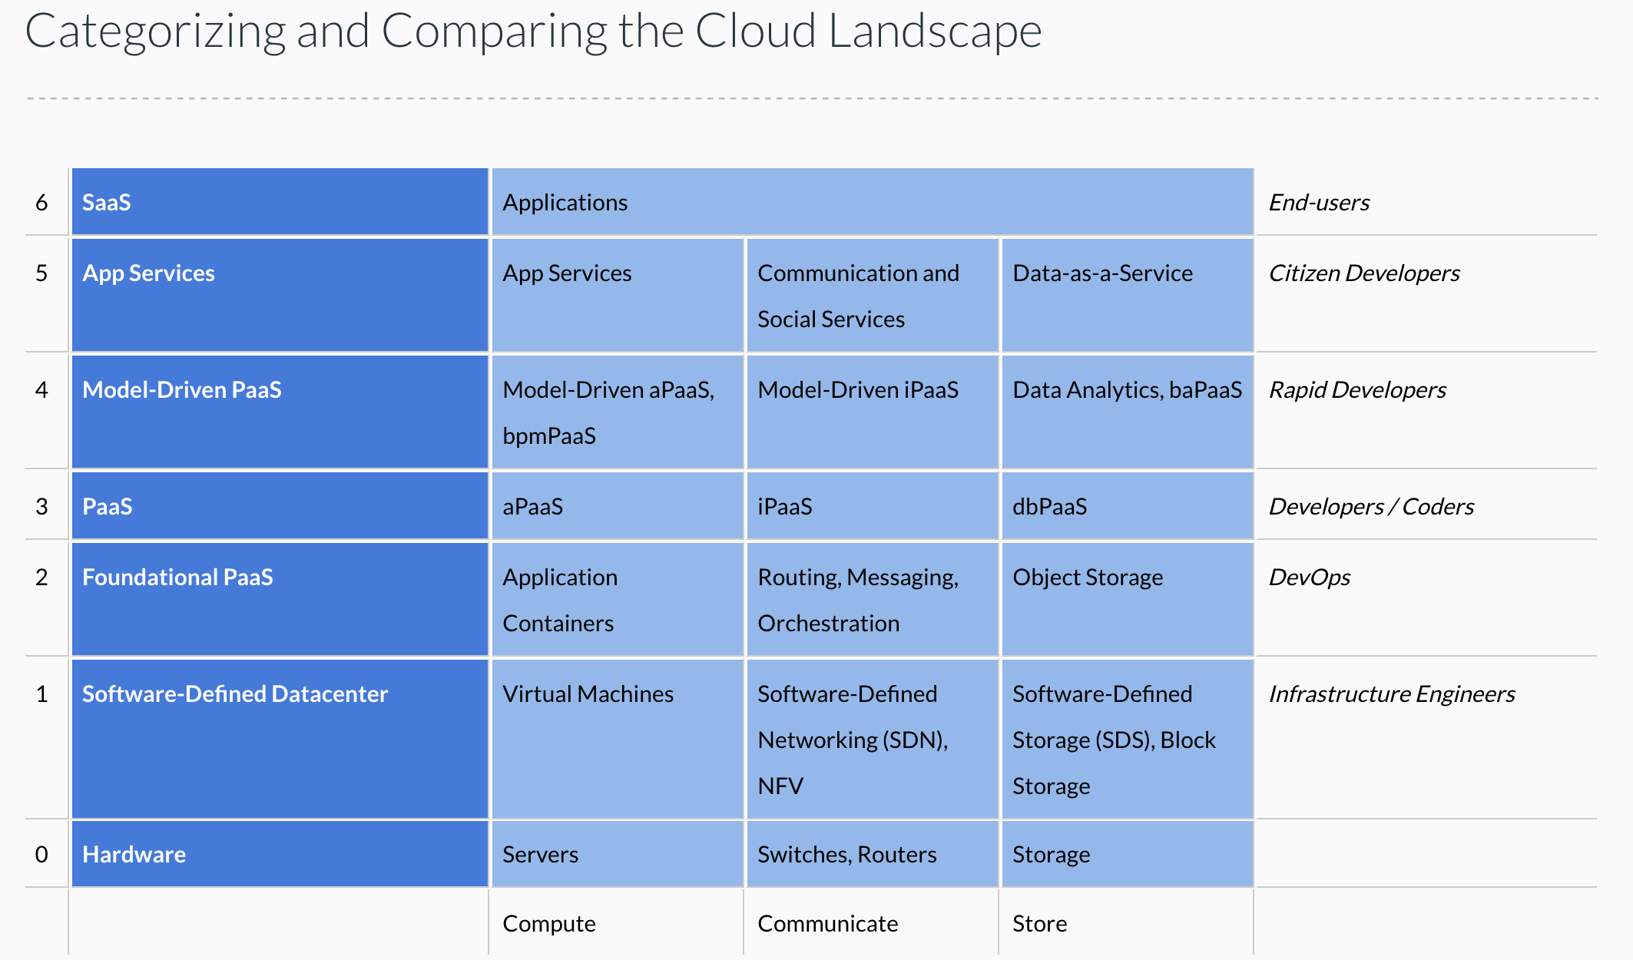
Cloud Concepts – One Perspective
http://www.theenterprisearchitect.eu/blog/2013/10/12/the-cloud-landscape-described-categorized-and-compared/

Slide 32
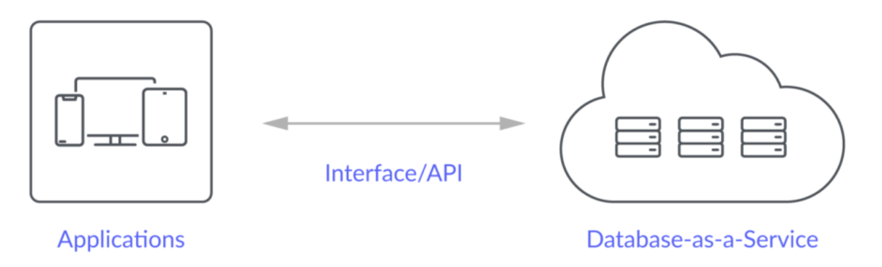
Database-as-a-Service
“A cloud database is a database that typically runs on a cloud computing platform and access to the database is provided as-a-service. There are two common deployment models: users can run databases on the cloud independently, using a virtual machine image, or they can purchase access to a database service, maintained by a cloud database provider. Of the databases available on the cloud, some are SQL-based and some use a NoSQL data model.
Database services take care of scalability and high availability of the database. Database services make the underlying software-stack transparent to the user.” (Wikipedia)
Let’s take a look at 3: Relational Data Service, Dynamo DB, MongoDB (Compass)

Slide 33
Overview (I) (https://en.wikipedia.org/wiki/NoSQL)
A NoSQL (originally referring to "non SQL" or "non relational")^{[1]} database provides a mechanism for storage and retrieval of data that is modeled in means other than the tabular relations used in relational databases. Such databases have existed since the late 1960s, but did not obtain the "NoSQL" moniker until a surge of popularity in the early twenty-first century,^{[2]} triggered by the needs of Web 2.0 companies such as Facebook, Google, and Amazon.com.^{[3][4][5]} NoSQL databases are increasingly used in big data and real-time web applications.^{[6]} NoSQL systems are also sometimes called "Not only SQL" to emphasize that they may support SQL-like query languages.^{[7][8]}
Motivations for this approach include: simplicity of design, simpler "horizontal" scaling to clusters of machines (which is a problem for relational databases),^{[2]} and finer control over availability. The data structures used by NoSQL databases (e.g. key-value, wide column, graph, or document) are different from those used by default in relational databases, making some operations faster in NoSQL. The particular suitability of a given NoSQL database depends on the problem it must solve. Sometimes the data structures used by NoSQL databases are also viewed as "more flexible" than relational database tables.^{[9]}

Slide 34
Overview (I) (https://en.wikipedia.org/wiki/NoSQL)
Many NoSQL stores compromise consistency (in the sense of the CAP theorem) in favor of availability, partition tolerance, and speed. Barriers to the greater adoption of NoSQL stores include the use of low-level query languages (instead of SQL, for instance the lack of ability to perform ad-hoc joins across tables), lack of standardized interfaces, and huge previous investments in existing relational databases.^{[10]} Most NoSQL stores lack true ACID transactions, … …
Instead, most NoSQL databases offer a concept of "eventual consistency" in which database changes are propagated to all nodes "eventually" (typically within milliseconds) so queries for data might not return updated data immediately or might result in reading data that is not accurate, a problem known as stale reads.^{[11]} Additionally, some NoSQL systems may exhibit lost writes and other forms of data loss.^{[12]} Fortunately, some NoSQL systems provide concepts such as write-ahead logging to avoid data loss.^{[13]} For distributed transaction processing across multiple databases, data consistency is an even bigger challenge that is difficult for both NoSQL and relational databases. Even current relational databases "do not allow referential integrity constraints to span databases."^{[14]}

Slide 35
Simplistic Classification (https://medium.com/swlh/4-types-of-nosql-databases-d88ad21f7d3b)
Relational is the foundational model.
We will see OLAP in a future lecture.
Subject of this lecture and part of HW4
We covered graphs and examples.

Slide 36
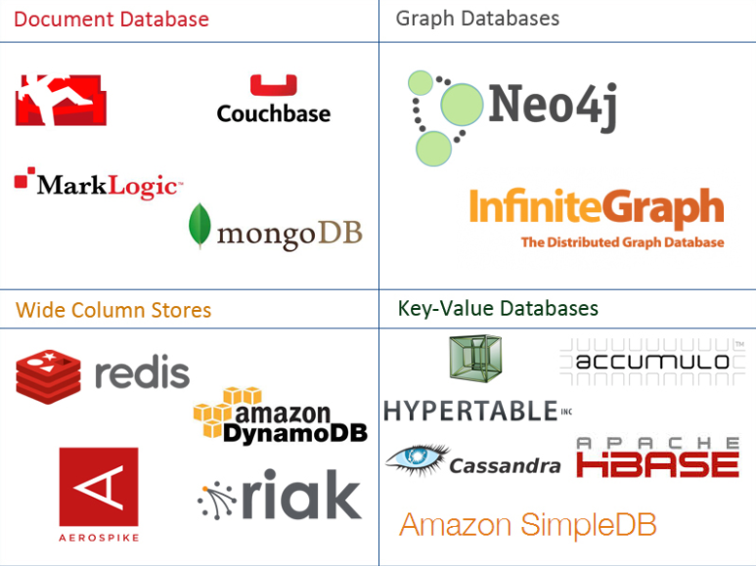
One Taxonomy

Slide 37
Core Transaction Concept is ACID Properties
http://slideplayer.com/slide/9307681
ACID
Atomic
“ALL OR NOTHING”
Transaction cannot be subdivided
Consistent
Transaction → transforms database from one consistent state to another consistent state
Isolated
Transactions execute independently of one another
Database changes not revealed to users until after transaction has completed
Durable
Database changes are permanent
The permanence of the database’s consistent state

Slide 38
ACID Properties (httpwww.tutorialspoint.com/dbms/dbms_transaction.htm)
A transaction is a very small unit of a program and it may contain several low-level tasks. A transaction in a database system must maintain Atomicity, Consistency, Isolation, and Durability − commonly known as ACID properties − in order to ensure accuracy, completeness, and data integrity.
Atomicity − This property states that a transaction must be treated as an atomic unit, that is, either all of its operations are executed or none. There must be no state in a database where a transaction is left partially completed. States should be defined either before the execution of the transaction or after the execution/abortion/failure of the transaction.
Consistency − The database must remain in a consistent state after any transaction. No transaction should have any adverse effect on the data residing in the database. If the database was in a consistent state before the execution of a transaction, it must remain consistent after the execution of the transaction as well.
Durability − The database should be durable enough to hold all its latest updates even if the system fails or restarts. If a transaction updates a chunk of data in a database and commits, then the database will hold the modified data. If a transaction commits but the system fails before the data could be written on to the disk, then that data will be updated once the system springs back into action.
Isolation − In a database system where more than one transaction are being executed simultaneously and in parallel, the property of isolation states that all the transactions will be carried out and executed as if it is the only transaction in the system. No transaction will affect the existence of any other transaction.

Slide 39
Serializability
“In concurrency control of databases, transaction processing (transaction management), and various transactional applications (e.g., transactional memory^{[3]} and software transactional memory), both centralized and distributed, a transaction schedule is serializable if its outcome (e.g., the resulting database state) is equal to the outcome of its transactions executed serially, i.e. without overlapping in time. Transactions are normally executed concurrently (they overlap), since this is the most efficient way. Serializability is the major correctness criterion for concurrent transactions' executions. It is considered the highest level of isolation between transactions, and plays an essential role in concurrency control. As such it is supported in all general purpose database systems.” (https://en.wikipedia.org/wiki/Serializability)

Slide 40
CAP Theorem
Consistency
Every read receives the most recent write or an error.
Availability
Every request receives a (non-error) response – without guarantee that it contains the most recent write.
Partition Tolerance
The system continues to operate despite an arbitrary number of messages being dropped (or delayed) by the network between nodes

Slide 41
Consistency Models
STRONG CONSISTENCY: Strong consistency is a consistency model where all subsequent accesses to a distributed system will always return the updated value after the update.
WEAK CONSISTENCY: It is a consistency model used in distributed computing where subsequent accesses might not always be returning the updated value. There might be inconsistent responses.
EVENTUAL CONSISTENCY: Eventual consistency is a special type of weak consistency method which informally guarantees that, if no new updates are made to a given data item, eventually all accesses to that item will return the last updated value.

Slide 42
BASE
Eventually-consistent services are often classified as providing BASE (Basically Available, Soft state, Eventual consistency) semantics, in contrast to traditional ACID (Atomicity, Consistency, Isolation, Durability) guarantees. Rough definitions of each term in BASE:
Basically Available: basic reading and writing operations are available as much as possible (using all nodes of a database cluster), but without any kind of consistency guarantees (the write may not persist after conflicts are reconciled, the read may not get the latest write)
Soft state: without consistency guarantees, after some amount of time, we only have some probability of knowing the state, since it may not yet have converged
Eventually consistent: If the system is functioning and we wait long enough after any given set of inputs, we will eventually be able to know what the state of the database is, and so any further reads will be consistent with our expectations

Slide 43
Eventual Consistency
Availability and scalability via
Multiple, replicated data stores.
Read goes to “any” replica.
PUT/POST/DELETE
Goes to any replica
Change propagate asynchronously
GET may not see the latest value if the update has not propagated to the replica.
There are several algorithms for conflict resolution
Detect and handle in application.
Clock/change vectors/version numbers
… …
get
put

Slide 44
ACID – BASE (Simplistic Comparison)
(Or other strategy)

Slide 45
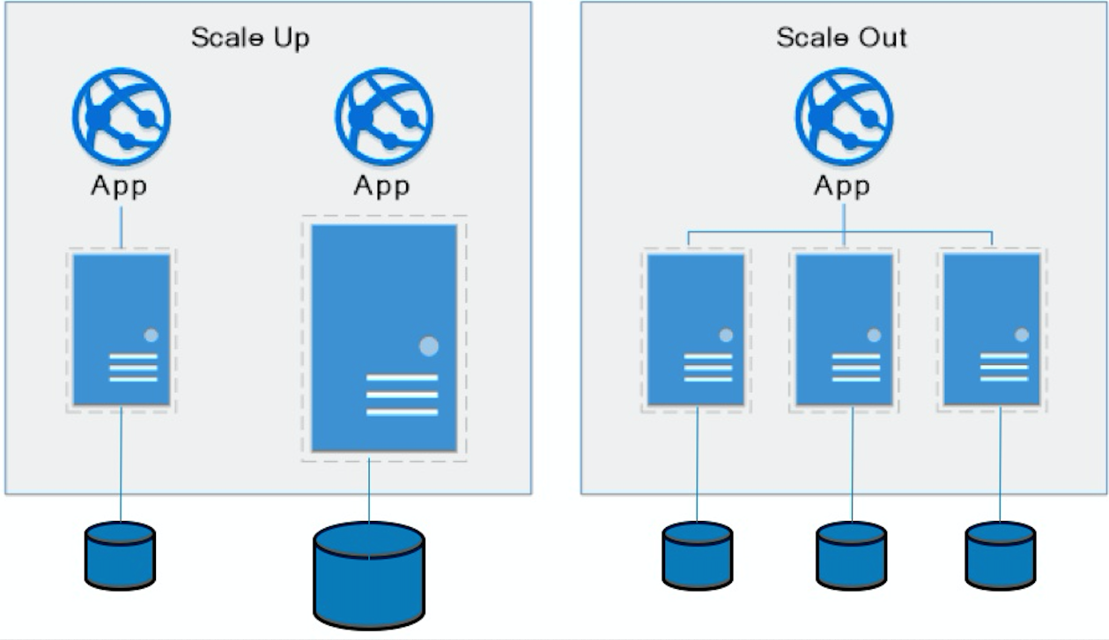
Approaches to Scalability
Scalability is the property of a system to handle a growing amount of work by adding resources to the system.
Replace system with a bigger machine, e.g. more memory, CPU, ... ...
Scale-up:
Less incremental.
More disruptive.
More expensive for extremely large systems.
Does not improve availability
Scale-out:
Incremental cost.
Data replication enables availability.
Does not work well for functions like JOIN, referential integrity, ... ...
Add another system.

Slide 46
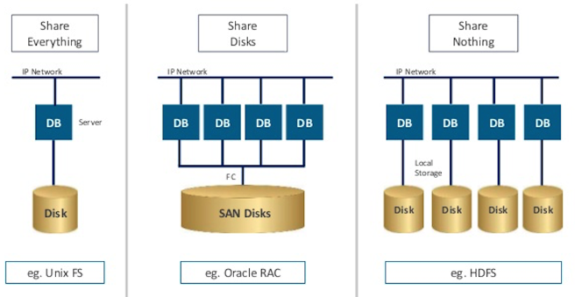
Disk Architecture for Scale-Out
Share disks:
Is basically scale-up for data/disks. You can use NAS, SAN and RAID.
Isolation/Integrity requires distributed locking to control access from multiple database servers.
Share nothing:
Is basically scale-out for disks.
Data is partitioned into shards based on a function f() applied to a key.
Can improve availability, at the code consistency, with data replication.
There is a router that sends requests to the proper shard based on the function.

Slide 47
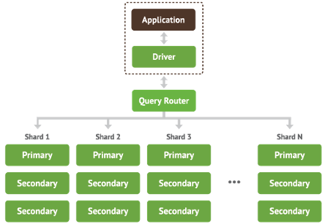
Shared Nothing, Scale-Out
MongoDB Sharding
DynamoDB Partitioning

Slide 48
DynamoDB
48 | E6156 – Topics in SW Engineering: Cloud Computing: Lecture 10: Design Patters, DynamoDB, Composition © Donald F. Ferguson, 2023

Slide 49
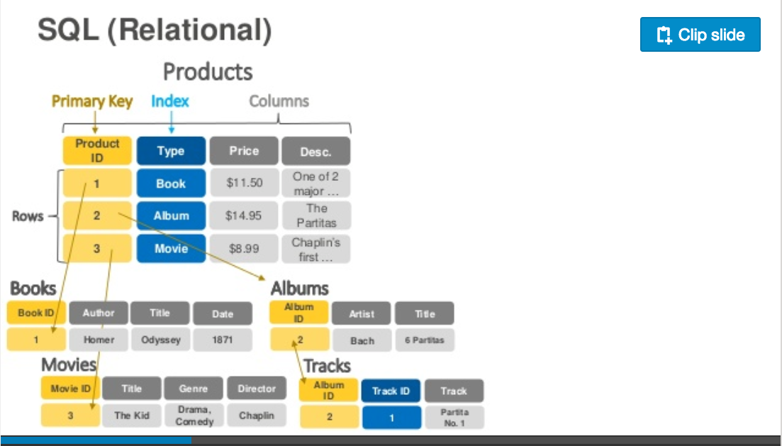
DynamoDB – Relational
https://www.slideshare.net/AmazonWebServices/introduction-to-amazon-dynamodb-73191648

Slide 50
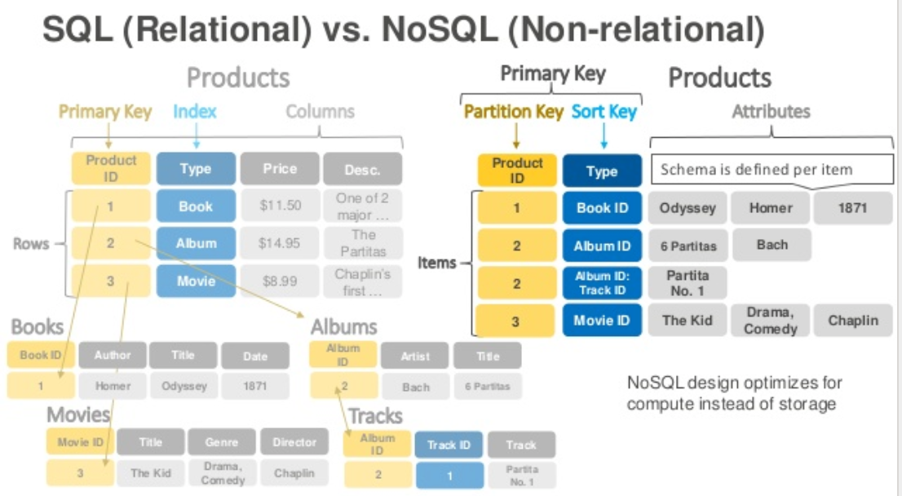
DynamoDB Data Model
Dynamo DB – Relational

Slide 51
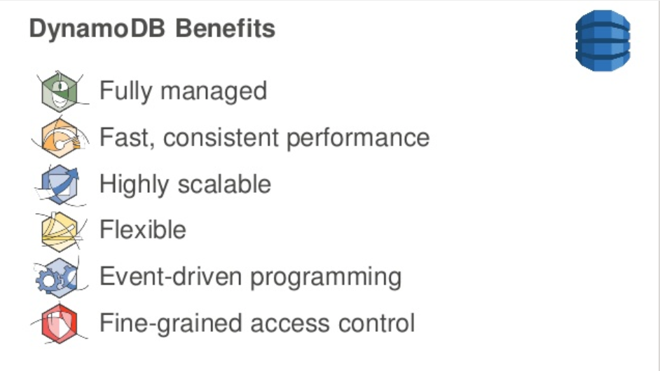
DynamoDB
DynamoDB Benefits

Slide 52
DynamoDB Hashing
DynamoDB – Hash Key

Slide 53
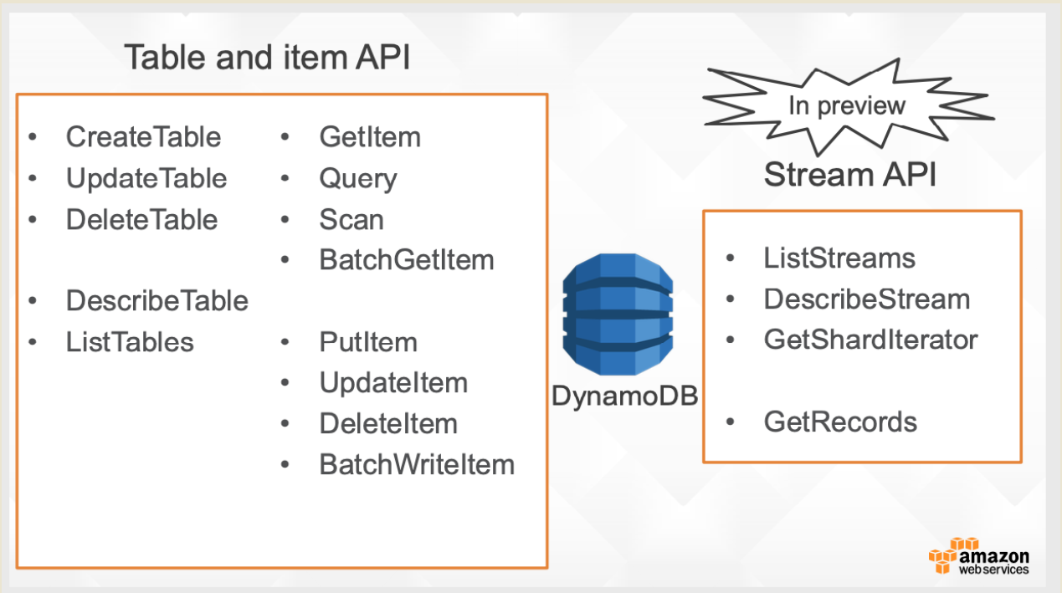
DynamoDB

Slide 54
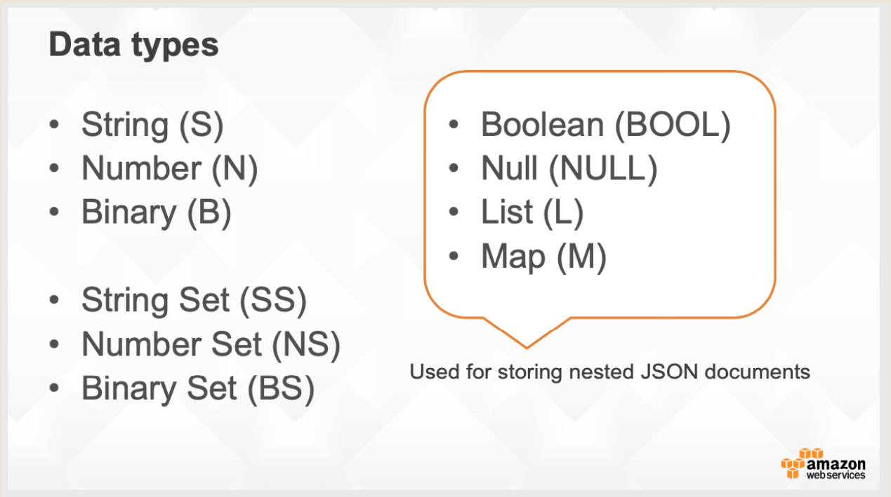
DynamoDB

Slide 55
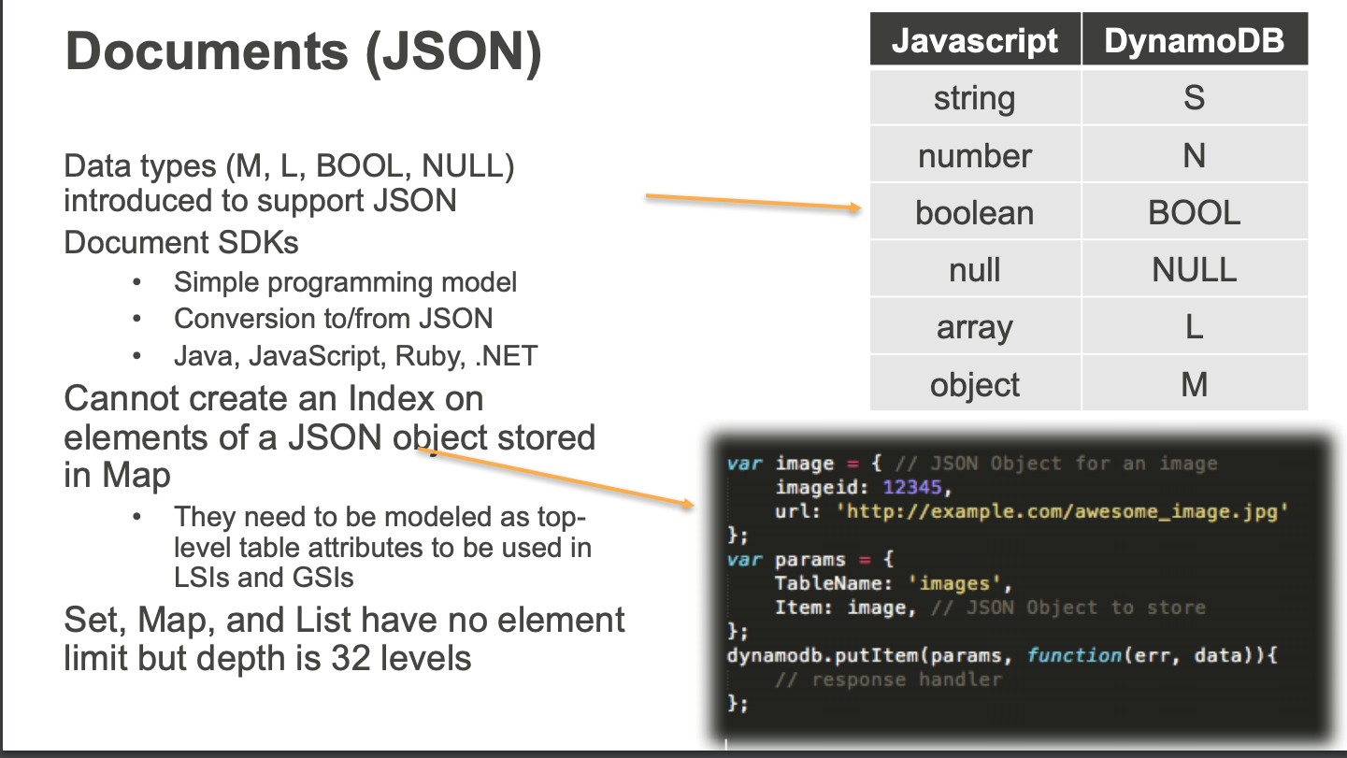
DynamoDB

Slide 56
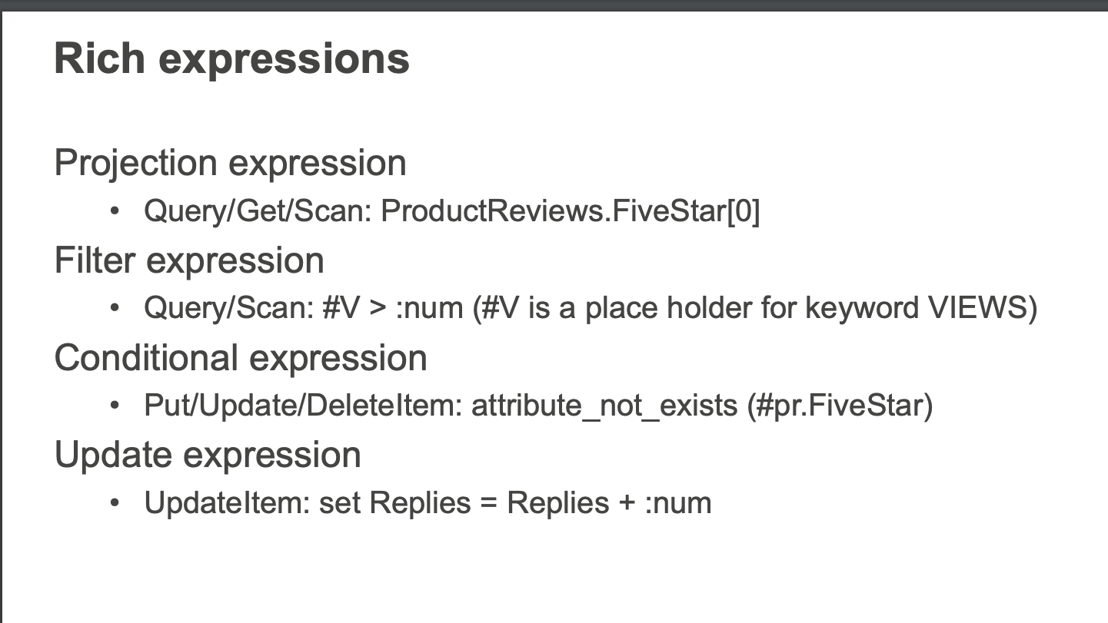
DynamoDB

Slide 57
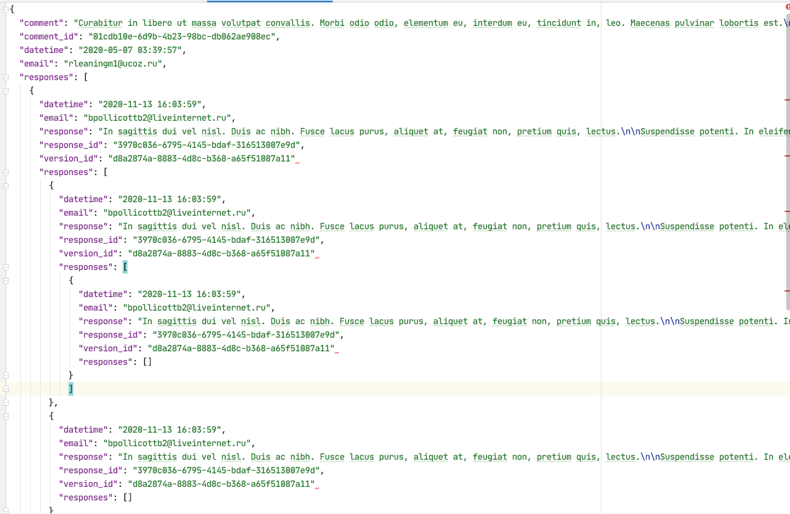
Document Databases – Semi-Structured Schema
The relation model has difficulties with some types of data:
Columns that are lists or maps
Nesting – things inside things
Discover you need a modified schema when you get a piece of data.
etc.
All of these are common for documented like data:
Threaded discussions.
Documents.
... ...
Document DBs emerged to handle these scenarios.
57 | E6156: Topics in SW Engineering – Cloud Computing/BaaS

Slide 58
DynamoDB and Documents
The relation model has difficulties with some types of data:
Columns that are lists or maps
Nesting – things inside things
Discover you need a modified schema when you get a piece of data.
etc.
All of these are common for documented like data:
Threaded discussions.
Documents.
... ...
Document DBs emerged to handle these scenarios.

Slide 59
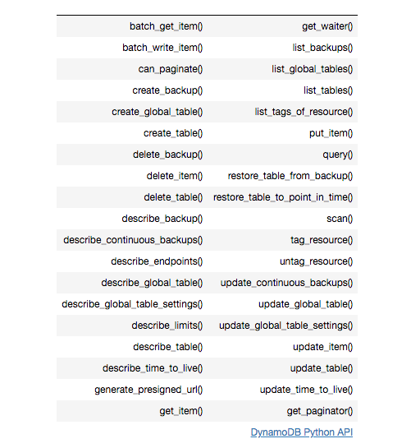
DynamoDB Summary
Achieves much greater scalability and performance than RDBMs
Does not support some RDBMs capabilities:
Referential integrity.
JOIN
Queries limited to key fields.
Non-key field queries are always scans.
Data model better fit for semi-structured data models and good fit for JSON
Maps
Lists

Slide 60
DynamoDB Summary
There are some very interesting properties.
I will provide some code examples.
I am trying to decide which cloud DBs you should use, if any.

